Slide 1
OSA6 - I/O and File Systems
COMP 256 – Dickinson College
Prof. Braught
Spring 2023

Slide 2
The Stored Program Architecture
Notes:
Talked a lot about the stored program architecture:
- memory and data currently being used must be in MM
- Fetch/decode/execute
How that is extended by Virtual Memory
Today, want to focus a little more on the I/O aspects.
We’ve touched on it here and there and we’ll review that.
Then we’ll discuss some new aspects and see how the OS creates the file and directory abstractions.

Slide 3

OS Abstractions for Input/Output
The Chasm: Devices are physical hardware with electrical signals providing access and control, but programs use instruction and users point and click.
E.g. A physical disk drive stores blocks of bytes, but users interact with files and directories (folders).
Hardware:
rooms, equipment
Program:
class, team, student
OS:
faculty, staff, coaches
Photo by: Steven Gerner, https://www.flickr.com/photos/
sgerner/16477700444/in/photostream/
Notes:
We’ll see the disk example in a bit.
Metaphor:
- Imagine a student needing a repair to their dorm
- The student would make a call to the college to make the request.
- An admin staff would answer the call and takes the request
- This is like the user process making a system call to request something from the operating system.
- The Admin will assign the task it to one of the staff in the maintenance department
- This is the OS handing the request off to the device to perform the task.
- Like asking the disk to read or write some data.
- Maintenance staff uses tools and equipment to fix the issue
- This is the disk actually doing the requested operation.
- Notice that the admin doesn’t need to know what tools are used or how the issue is fixed.
- The admin, may not even know who actually does the repair.
- The admin just knows how to ask that the work be done and has permission to do so.
- When the repair is complete, the worker notifies admin that the work is done
- This is like the disk generating a hardware device interrupt
- It starts the OS running, i.e. gets the admin’s attention.
- Finally, the admin notifies student that the work is complete.
- This is the OS returning the data to the process..

Slide 4
The Device Stack
User Interface (CLI/GUI)
HLL Application Program Code
The device stack creates layers of abstraction, each used by the neighboring layers, that provide simplified and consistent access to a diverse range of devices.
Compiler/Interpreter Library
Operating
System
Interrupt Handlers
System Calls
Device Interrupts
Device Drivers
Physical Hardware
IRQ
PIC
Notes:
Example of a user opening a file in an application:
- User chooses file -> open from a menu.
- The HLL code of that program (which of course is ML now) makes a call to a library function (also ML now)
- The library makes a system call to ask the OS to read the file.
- The system call handler relays a command to the device driver
- The device driver is a piece of software that knows how to talk to the hardware.
- More on that in a moment.
- The device driver translates the command from the OS into the signals required by the device.
- The device processes the command and reads the data
- When it is done the device generates an interrupt to tell the OS the data is available
- The interrupt causes the appropriate IRS in the OS to run.
- The ISR uses the device driver to talk to the device to get the data
- The data is passed back to the library
- The library passes the data back to the HLL program code
- The HLL program code updates the GUI or CLI displayed to the user.
In the Metaphor this is like:
- A student calls maintenance department for service
- The phone, and phones service are UI/HLL/Library
- The Admin who answers the call is the system call handler
- The admin as part of the OS operating in kernel mode
- assesses the caller’s credentials and permissions to ask for the task.
- assigns the task, (time/location/description) to a member of the maintenance staff (the device driver)
- This worker has expertise in what need to be fixed
- They can translate the general task into the specific things that need to be done.
- This is the device driver.
- The maintenance staff interacts with the hardware using task specific tools
- When the task is done
- The system being fixed comes back and is noticed by the admin (like an interrupt).
- The admin then relays information back through the phone to the student that the task is complete.
Notice:
- There is only communicate between adjacent levels of abstraction (except for the Interrupt and IRQ)
- Device driver and hardware have no clue who made the request.
- User making the request doesn’t know the specific system call or device driver.

Slide 5
Device Drivers:
The OS defines a common set of I/O operations (read/write…) that can be performed.
Device drivers translate the common operations into device specific commands and signals.
Three broad classes of devices:
Character Devices
Keyboard, Mouse
Block Devices
Disk drives (HDD/SSD)
Packet Devices
Network Interface Card (NIC)
Notes:
The idea here is that all disks can read and write.
But disks manufactured by different companies may each work a little differently.
Instead of the OS knowing about every possible different one
- The OS just defines the common functions for the device.
- The device manufacturer then can provide a device driver that translates the common operations into the device specific commands and signals.
This is kind of like an interface in Java:
- The OS defines the interface
- User code can call functions in the Interface via system calls.
- The device drivers then provide different implementations of those interfaces for different devices.
So the same common operation (e.g. write) will have different implementations depending upon the specific device installed.
- This is sort of like a polymorphic function
- same function does things differently based upon what exact device is attached.
- E.g. HDD vs SSD.
All devices are categorized into three broad categories
- The common operations are then defined for each of these categories.
- Character Devices
- Transfer data one character (a byte or a few bytes) at a time.
- E.g. a keyboard or a mouse or an old printer.
- Block Devices
- Transfer data in fixed size blocks of bytes at a time.
- E.g. disk drives (HDD or SSD)
- Packet Devices
- Transfer data in variable size “packets”
- E.g. network devices
- The amount of data transferred depends on what is requested.
- Large amounts are divided up into multiple packets.

Slide 6
A Character Device: Keyboard Input
User presses a key
Keyboard signals the PIC
PIC sends IRQ to Control Unit
Control Unit transfers control to ISR
Keyboard ISR:
PRESERVE REGs
Process interrupt:
Get the char from KB device
Identify the active window
Deliver data to the process
PCB → READY
RESTORE REGs
INT_RETURN
Application Program
Receive data as return from call to a library function.
Process (e.g. display) data.
Notes:
Imagine a user presses a key on the keyboard
- It should show up in the active window on the screen.
- How does that happen?
The sends a signal to the Programmable Interrupt Controller (PIC)
The PIC translates that to an IRQ
The IRQ causes a device interrupt handler (The Keyboard ISR) to execute
- The ISR preserves the registers of the currently running process so that it can use those registers for its own work.
- The ISR communicates with the keyboard through a device driver to read the key that was typed.
- The ISR uses data in the OS to determine which window (i.e. process) is active
- Delivers the data to that process
- Moves that process’ PCB back to the ready queue
- Restores the registers so that the previously running process can pick up where it left off.
- Returns from the interrupt
- Sets the CPU to user mode and the PC to what it was for the previously running proces.
When the process that received the data runs again it will pick up where it left off.
- That will be with a value being returned from a call to a library function that reads a key from the keyboard.
- The process will take that return value and display it in its window
- Also, by a system call to the OS to ask it to do that!

Slide 7
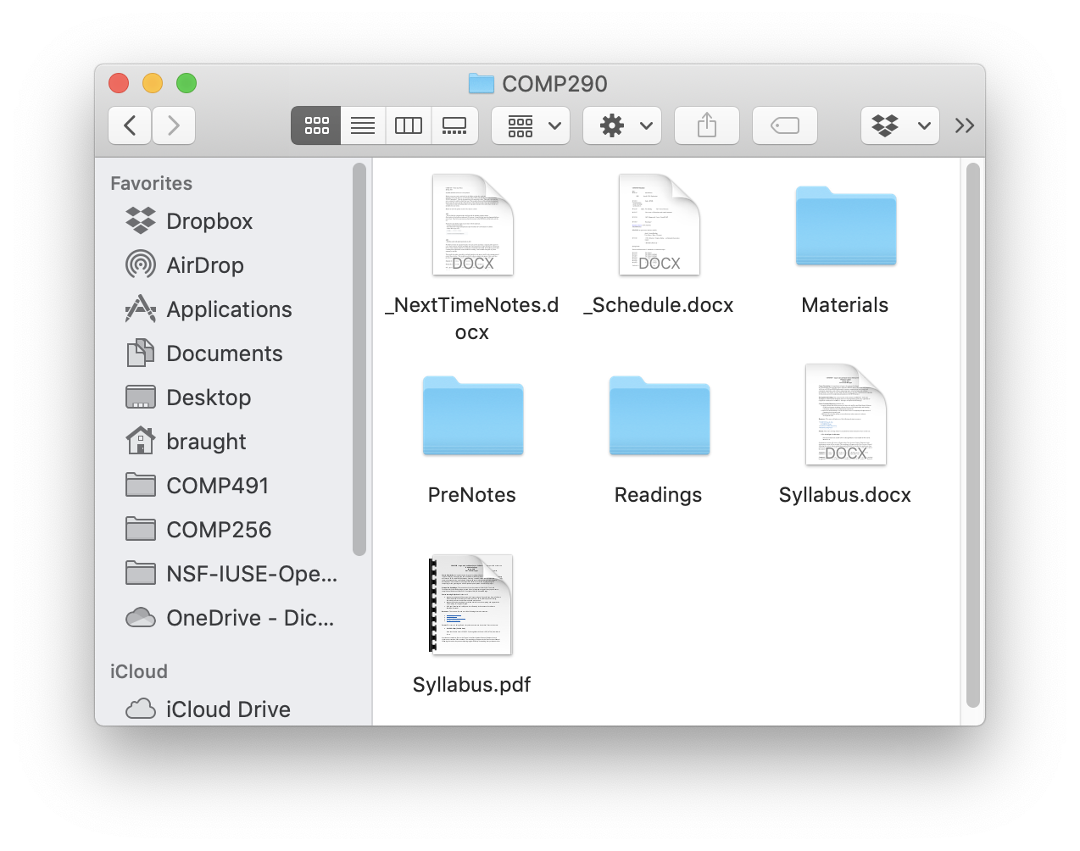
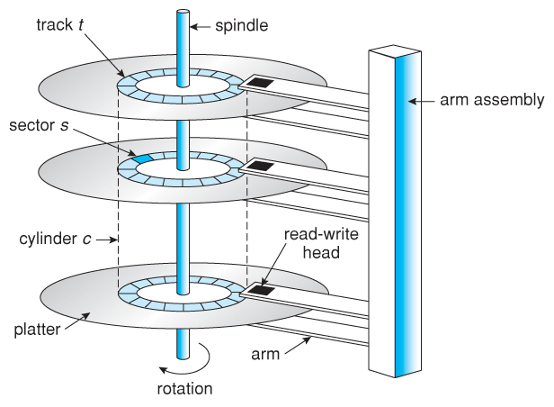
Block Devices: Files & Directories vs Disks
Photo by: Steven Gerner, https://www.flickr.com/photos/
sgerner/16477700444/in/photostream/
Image from: https://www.partitionwizard.com/help/what-is-chs.html
Notes:
Disks as block devices are an interesting case
- We think of files and directories
- But the disk stores only blocks (sectors) of data
So how does that chasm get bridged?

Slide 8
A Block Device: Hard Disk Drive
Data on a Hard Disk Drive (HDD) is accessed in chunks of bytes called sectors.
Every sector has a unique c:h:s address:
c: cylinder
h: head
s: sector
Linear Block Addressing (LBA) alternative.
h
Image from: https://www.partitionwizard.com/help/what-is-chs.html
Notes:
Let’s take a closer look at how hard disk drives work:
- a HDD is a collection of spinning platters
- each platter has two surfaces coated with magnetic material
- each bit stored is represented as a magnet with north pole up or north pole down.
- the orientation of magnetic bits are read using the read-write head
- those heads are mounted on an arm that moves them in and out over the disk
- the collection of circles traced out by all the heads is called a cylinder
- so as the arms move, the heads move from cylinder to cylinder.
- the part of the cylinder on a given surface is called a track.
- each track is divided into sectors
- each sector is typically 512 bytes
The location of any sector on the disk can be uniquely specified as a C:H:S address.
- the cylinder indicates how far in or out the arm
- the head indicates which surface
- the sector indicates which part of the track on that surface
Linear block addressing is an alternative way of addressing disks
- Just number every sector in some way from 0…Max
- It is then up to the device hardware to figure out where that sector actually is.
Note:
- SSD’s or ThumbDrives do not have these physical attributes.
- However, their device driver interfaces make it look like they do.
- So for example, when reading and writing an SSD data can still be addressed using LBA
- The device driver translates that to the way that SSDs store data which is nothing like a HDD.
- But it simplifies things significantly from the OS perspective.

Slide 9
OS Data Structures: File System
The OS must maintain data structures that:
map from the names of files and directories to the disk sectors (c:h:s or LBA) that contain the data.
track the free space on the disk
Notes:
So somehow a file must be made up of sectors.
It is the job of the OS to keep track of which sectors make up which files.
- So if we open homework.docx then the OS will need to find the sectors containing the data on the disk.
It also needs to keep track of what space on the disk is used and free.
- So that new files can be created
- And existing files can be deleted and the space reused.

Slide 10
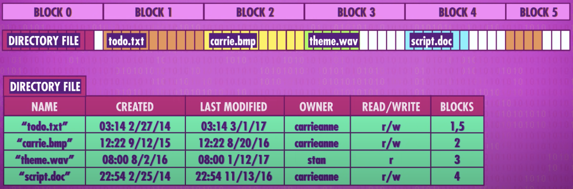
A Flat File System
Image from: Files & File Systems: Crash Course Computer Science #2 https://www.youtube.com/watch?v=KN8YgJnShPM
Notes:
A simple way to do this is with a Flat File System.
In a flat file system, the first block (i.e. sector) on the disk is set aside to hold the directory file.
- The directory file contains information about all of the other files on the disk.
- The name of the file (“todo.txt”)
- The dates it was created and last modified.
- Who owns the file
- What operations you are allowed to perform on the file (read/write or read only)
- This is the information that the OS would check when a process asks to read or write a file to check if it is allowed.
- If not, then it would likely terminate the process.
- Which blocks on the disk make up the file.
- E.g. (1 and 5 for ”todo.txt”)
When data is added to a file, it is added to the end of the block
- For example, if script.doc has data added to it, block 3 will become more full.
If a file out grows its block (e.g. like ”todo.txt”) then if more data is added, the OS will add additional blocks to the file by noting them in the directory block.
Note: If a file does not fill a block, that space cannot be used by any other file.
Also note: This is a simplified conceptual example.
Each OS will have their own way of storing this data.
It will maintain the data structures that it uses somewhere:
- They will all be on the disk as shown
- And the parts that are in use will need to be in the main memory also.
- I.e. to find a file the directory block will need to be brought into main memory so that it can be searched.

Slide 11
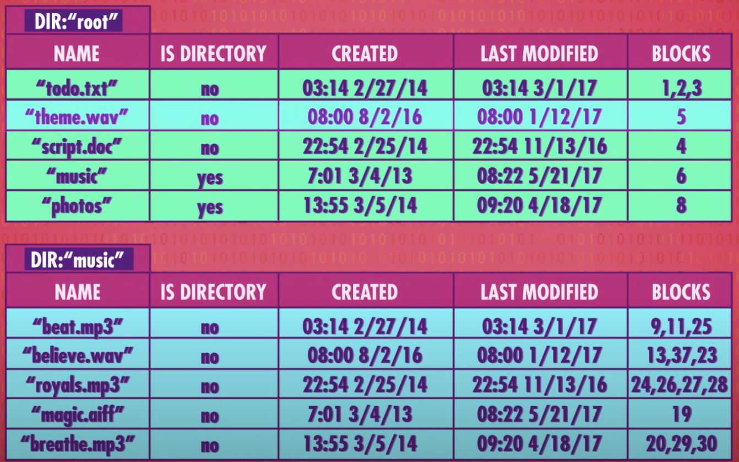
A Hierarchal File System
Image from: Files & File Systems: Crash Course Computer Science #2 https://www.youtube.com/watch?v=KN8YgJnShPM
Notes:
On (almost) all operating systems you can now store files in directories
And create new directories (sub-directories) within other directories.
This is called a hierarchical file system
To do d this we just make the data structures stored by OS a little more complicated.
- Each entry in the root directory has an ”IS DIRECTORY” flag
- If that flag is yes (e.g. a 1) then that file is actually another directory file
- The contents of that directory file are a sub-directory of the one above
- E.g. the “music” directory is listed in the ”root” directory
- Therefore, “music” will appear in the the “root” directory if we were to look at the files in a graphical window.

Slide 12
Block Device: Disk Write
User chooses ”Save” from program memu
User program requests file write
Call to library function
fputs(f, “Hello file!”);
Compiler Library Function:
Make system call (INT_IRQ)
Control Unit:
Transfers control to System Call ISR via interrupt vector
System Call ISR
Transfers control to Disk Write Handler via system call vector.
Disk Write System Call Handler:
SAVE CONTEXT to PCB
PCB → WAITING
Process Write Request
While data in request to be written
Add data to buffer block
If buffer block is full:
Find free block on disk
Update OS data structures
REQUEST DISK WRITE
CALL OS SCHEDULER
Notes:
This is similar to what we saw earlier for the keyboard character device.
The user program will request a file write
- Maybe the user chose “Save” from a menu in the program.
The HLL code in the program will call the library function to request that the OS do the disk write.
The library function will translate that request into the appropriate system call
The Control Unit will, via the interrupt vector, invoke the ISR for system calls.
The ISR for the system call will use the system call vector to invoke the System Call Handler
- For the disk write handler in this case.
The Disk write handler will make the write request of the operating system.
- It will save the context (registers) of the running process to its PCB
- Deep freeze it!
- It will move the PCB of that process to the waiting state so that it waits for the write to complete.
- The ISR will then process the request
- It maintains a buffer block for each open file representing a block on the disk.
- This buffer is in main memory owned by the OS.
- While there is still data in the request to be written
- then find a place on disk to put it.
- Update the OS data structures to show that:
- Directory: The written block on disk belongs to the file
- Free Space Map: That the written block on disk is no longer free for others to use.
- Write the block to the disk
- Finally, use the scheduler to pick a new process to run.
Note: Again this is a simplification,
- It is more complex and more optimized than that in practice.
- But that is the basics of what would need to happen.

Slide 13


Acknowledgments
Slide Template From:
https://creativecommons.org/licenses/by/4.0/
Slide Content Licensed as:
Creative Commons Attribution-NonCommercial-ShareAlike 4.0 International License.
Notes:
Note: Individual images may be covered by their own licensing agreements and were incorporated here under fair use. Their use in this slide deck does not change or alter their licensing.

Slide 14
Device Drivers
A device driver allows the OS to interact with a manufacturer specific device through a uniform interface:
Three main types:
Block Devices
Character Devices
Packet (Network) Devices
Notes:
and write variable size “packets” of bytes at a time.

Slide 15
File Read: The HLL User Program View
menu_file_open(char *fname) {
FILE *f = fopen(fname,”rw”);
n = the size of file f
char *buffer = (char *)malloc(n+1);
fgets(f, n, buffer);
process the data in buffer
fclose(f);
}
HLL Program
Function Call
fgets(f, n, b) {
PUSH f
PUSH n
PUSH b
LOAD SCR #0
INT_IRQ #18
RET
}
Library Code
Notes:
Going to walk through this in more detail
Give us a chance to review the mechanisms we saw earlier.
Place them into context and see the bigger picture.
Looks to HLL like any other function call.
- just call fgets, buffer gets filled with the contents of the file.
- Assembly and ML look just like any other call.
Italics are pseudo code…
Note that fopen and fclose are also system calls.
- fopen will ask OS to open the file
- OS will check if user has permission to read and write that file.
- if so will check that no other process is already using it.
- will update its structures to reflect that this process has the file open.
- fclose will update structures indicating that the file has been closed and others can use it now.
Lets look more cloesly at the fgets call
- Put the parameters for the system call on the stack
- pseudo code just to connect to what we’ve learned
- Load system call register (SCR) with 0 to indicate a disk read request
- arbitrary value – assigned by OS creator.
- Generate interrupts – the system call.
- Transfers control to OS SC Handler in kernel mode.

Slide 16
File Read: The OS View
Main Memory
fgets(f, b) {
PUSH f
PUSH b
LOAD SCR #0
INT_IRQ #18
RET
}
0:
…:
996:
IVect[0] 1000: 8000
[…] …: …
[18] 1072: 9230
…: …
SCVect[0] 2000: 10000
[1] 2004: 12568
…:
3680:
…:
…:
BIOS
Library Code
ISR18 {
PC ← SCVect[SCR]
RET
}
DISK_READ() {
Save Context
PCB → WAITING
GET PARAMS
REQUEST READ
via Device Driver
JUMP SCHEDULER
}
Interrupt / System Call
OS
SET_KERNEL_MODE
RA ← PC
PC ← IVect[IRQ]
Control Unit
Notes:
Interrupt / System call
- Processor switched to kernel mode
- save return address
- branch to the routine to do the disk read.
Disk read
- save the context of the running process
- Put it into the waiting state
- Use the device driver to start the disk doing the read
- the disk is slow so it will work on that
- In the meantime…
- invoke the scheduler to pick a new process to run

Slide 17
Accessing Disk Data
Data on a Hard Disk Drive (HDD) is accessed in chunks of bytes called sectors.
Every sector has a unique c:h:s address:
c: cylinder
h: head
s: sector
Linear Block Addressing (LBA) alternative.
h
Image from: https://www.partitionwizard.com/help/what-is-chs.html
Notes:
Hard Disk Drives
- collection of spinning platters
- each with two surfaces coated with magnetic material
- orientation of magnetic bits are read using the read-write head
- those heads are moved in an our on arms
- the collection of circles traced out by all the heads is called a cylinder
- the part of the cylinder on a given surface is called a track.
- the track is divided into sectors
- 512 bytes – typically
The location of any sector can be given as a C:H:S address.
- cylinder says where the arm is
- head says which surface
- sector says which part of the track
Note:
- SSD’s or ThumbDrives do not have these physical attributes.
- However, their device driver interfaces make it look like they do.

Slide 18
File Read: The OS View Cont…
DISK_ISR() {
Save Context
…
PCB → READY
Restore Context
INT_RETURN {
PC ← RA
SET_USER_MODE }
}
Main Memory
REQUEST READ {
Find C:H:S for file f
PUSH Parameters
CALL Device Driver
RET
}
0:
…:
996:
IVect[0] 1000: 8000
[…] …: …
[18] 1072: 9230
…: …
SCVect[0] 2000: 10000
[1] 2004: 12568
…:
3680:
…:
…:
BIOS
ISR18 {
PC ← SCVec[SCR]
RET
}
Function Call
DISK_READ() {
Save Context
PCB → WAITING
GET PARAMS
REQUEST READ
via Device Driver
JUMP SCHEDULER
}
DISK_DevDriver_READ(C:H:S) {
Translate read C:H:S into
disk specific commands.
Issue commands to disk hardware.
RET
}
OS
Notes:
Let’s look more closely at the requesting of the read…
Use OS data structures and information on the disk to find CHS location for file
- If clever they’ll realize this requires disk access too… but don’t need to push it.
Function call within the OS to the device driver.
- Device driver
- Knows how to talk to the specific type of disk
- Ask disk to read data at CHS
- RET… RET
Jump to scheduler.

